Slide 1
Binary Exponentiation

Slide 2

Binary Exponentiation
Need to compute $a^{n}$.
Simple multiplying $\underset{n}{\underbrace{a∙a∙a∙⋯ ∙a}}$ is O(n).
We want to calculate faster.

Slide 3

Binary Exponentiation
Let’s define recursive function power(a, n):
power(a, n) = $\left\{\begin{aligned}if n is odd, then power\left(a, n −1\right)∙a \\ else, then {power\left(a, n/2\right)}^{2}\end{aligned}\right.$

Slide 4

Binary Exponentiation Example
$a^{38}$
${{(a}^{19})}^{2}$
${{(a}^{18}∙a)}^{2}$
${(({a^{9})}^{2}∙a)}^{2 }$
${({{(a}^{8}∙a)}^{2}∙a)}^{2}$
${({{{((a}^{4})}^{2}∙a)}^{2}∙a)}^{2}$
${({{(({{(a}^{2})}^{2})}^{2}∙a)}^{2}∙a)}^{2}$
${({{{(((a∙a)}^{2})}^{2}∙a)}^{2}∙a)}^{2}$
Need to perform 7 operation instead of 38.

Slide 5

Binary Exponentiation
Complexity:
On each step we or dividing $n$ by 2, or decreasing $n$ by 1.
Number of decreases is not greater than divides, because after each decreasing $n$ becomes even.
So because of dividing final complexity is $O(log⁡(n)).$

Slide 6
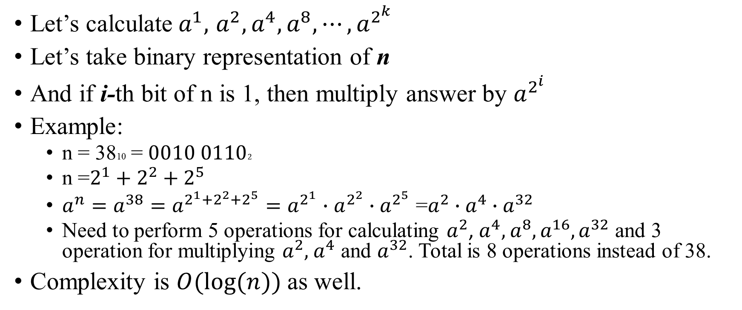
Binary Exponentiation Other algorithm
Let’s calculate${ a}^{1},$ $a^{2}, a^{4}, a^{8}, ⋯, a^{2^{k}}$
Let’s take binary representation of n
And if i-th bit of n is 1, then multiply answer by $a^{2^{i}}$
Example:
n = 3810 = $0010 01102$
n =$2^{1}+$ $2^{2}+$ $2^{5}$
$a^{n}=a^{38}=a^{2^{1}+2^{2}+2^{5}}=a^{2^{1}}∙$ $a^{2^{2}}∙$ $a^{2^{5}}$ =$a^{2}∙$ $a^{4}∙$ $a^{32}$
Need to perform 5 operations for calculating $a^{2}$, $a^{4},$ $a^{8},a^{16}, a^{32}$ and 3 operation for multiplying $a^{2},$ $a^{4}$ and $a^{32}$. Total is 8 operations instead of 38.
Complexity is $O(log⁡(n))$as well.

